Slide 1
ONLINE STORE CART AND ORDER PIPELINE
PROBLEM SOLVING USING PROGRAMMING (JAVA) • 15 OCTOBER 2026
A MENU-DRIVEN JAVA APPLICATION
Product browsing • Cart management • Search • Sorting • Order persistence
PROJECT TEAM
Toshita Yalamanchili | 2620030361
V. Mahesh | 2620030339
COURSE
Problem Solving Using Programming (Java)
Course Code: 26SC1101E
KL Deemed to be University • Bachupally
ONLINE STORE CART AND ORDER PIPELINE | JAVA PROJECT
01 / 12

Slide 2
ABSTRACT
PROJECT OVERVIEW
ABSTRACT
TECH STACK
The Online Store Cart and Order Pipeline is a menu-driven Java console application that demonstrates core programming concepts through a simple shopping workflow. Users can view available products, add items and quantities to a cart, inspect the cart total, search products by name, sort the product catalogue by price, and place an order.
The application models products using a class and interface, stores cart quantities in a HashMap, and uses methods to separate each operation. String handling, library sorting, lambda expressions, Stream API processing, and file I/O are used to make the program modular and practical. When an order is placed, its total is appended to a text file for basic persistence.
Java
Scanner • Arrays • HashMap
Streams • java.nio.file
KEY FEATURES
Product listing
Add to cart and view bill
Name-based search and price sorting
Save order total to orders.txt
ONLINE STORE CART AND ORDER PIPELINE | JAVA PROJECT
02 / 12

Slide 3
UNDERSTANDING THE PROBLEM STATEMENT
WHY THIS PROJECT?
PROBLEM
OBJECTIVES
A small store needs a simple way to display products, record selected quantities, calculate a bill, and keep a basic order record without a graphical interface or database.
• Present a fixed product catalogue
• Validate product IDs and quantities
• Calculate cart totals accurately
• Support search and sorting
• Save completed order totals to a file
INPUT → PROCESS → OUTPUT
SCOPE & LIMITATIONS
INPUT: Menu choice, product ID, quantity, search text
PROCESS: Validate input, update cart, find/sort products, calculate total
OUTPUT: Product list, cart bill, search results, order confirmation
Console-based prototype with four predefined products. It does not include user accounts, payment processing, stock management, a database, or a graphical user interface.
ONLINE STORE CART AND ORDER PIPELINE | JAVA PROJECT
03 / 12

Slide 4
CO1 | JAVA FOUNDATIONS & CONSOLE I/O
COURSE OUTCOME MAPPING • BASED ON IMPLEMENTED JAVA SOURCE
CO1: Translate a real-world problem into an algorithm and working Java program using primitive types, expressions and sequential console I/O.
Concepts used
Where in the code
Scanner for keyboard input
Variables and constants
Primitive numeric types
Console output with System.out
Scanner sc = new Scanner(System.in)
Product IDs, prices and quantities
readInt() for numeric input
System.out.println() for menus and results
Project contribution
Provides interactive menu choices and captures product IDs and quantities. Numeric input is validated by catching NumberFormatException.
ONLINE STORE CART AND ORDER PIPELINE | JAVA PROJECT
04 / 12

Slide 5
CO2 | CONTROL FLOW
COURSE OUTCOME MAPPING • BASED ON IMPLEMENTED JAVA SOURCE
CO2: Design control flow using selection and iteration to solve problems requiring decisions and repetition.
Concepts used
Where in the code
do–while loop
switch menu selection
if / else validation
for-each loop and early return
main(): menu repeats until choice 7
switch(choice): routes each feature
addToCart(): validates ID and quantity
showCart() / placeOrder(): handle empty cart
Project contribution
Keeps the store menu running, selects the requested operation, rejects invalid entries, and prevents ordering from an empty cart.
ONLINE STORE CART AND ORDER PIPELINE | JAVA PROJECT
05 / 12

Slide 6
CO3 | METHODS & DATA PROCESSING
COURSE OUTCOME MAPPING • BASED ON IMPLEMENTED JAVA SOURCE
CO3: Modularise solutions using methods and recursion, and store/process homogeneous data with arrays.
Concepts used
Where in the code
Methods for decomposition
Product[] array
Enhanced for loop
Method overloading and recursion are defined
showProducts(), addToCart(), search()
sortProducts(), placeOrder(), find()
Product[] products stores catalogue
Two discount() overloads and countProducts() recursion are present
Project contribution
Separates features into readable methods and stores the fixed product catalogue in an array. Note: discount() and countProducts() are defined but not called in the current workflow.
ONLINE STORE CART AND ORDER PIPELINE | JAVA PROJECT
06 / 12

Slide 7
CO4 | OBJECT-ORIENTED DESIGN
COURSE OUTCOME MAPPING • BASED ON IMPLEMENTED JAVA SOURCE
CO4: Model a problem domain with classes and objects, encapsulation and relationships, and use exception handling.
Concepts used
Where in the code
Product class and objects
private final fields
Parameterized constructor
Identifiable interface
try–catch exception handling
Product implements Identifiable and Comparable<Product>
private id, name and price fields
getId(), compareTo(), toString()
NumberFormatException and IOException catches
Project contribution
Represents each catalogue item as a Product object, keeps fields private, and handles invalid numeric input and file-write failures.
ONLINE STORE CART AND ORDER PIPELINE | JAVA PROJECT
07 / 12

Slide 8
CO5 | STRINGS, SORTING & FILE I/O
COURSE OUTCOME MAPPING • BASED ON IMPLEMENTED JAVA SOURCE
CO5: Process textual data, apply library algorithms for searching/sorting, and persist data using file I/O.
Concepts used
Where in the code
String trim() and toLowerCase()
contains() text search
StringBuilder bill construction
Arrays.sort() with Comparator
Files.writeString() and Path
search(): case-insensitive name matching
showCart(): builds bill text
sortProducts(): sorts by price
placeOrder(): appends order total to orders.txt
Project contribution
Allows flexible product-name searches, orders the catalogue by price, formats a cart bill, and stores each order total in a text file.
ONLINE STORE CART AND ORDER PIPELINE | JAVA PROJECT
08 / 12

Slide 9
CO6 | COLLECTIONS & STREAMS
COURSE OUTCOME MAPPING • BASED ON IMPLEMENTED JAVA SOURCE
CO6: Manage collections and express data processing declaratively using the Collections framework, lambdas and Stream pipelines.
Concepts used
Where in the code
HashMap<Integer, Integer>
getOrDefault() and put()
forEach() lambda
Stream mapToDouble() and sum()
filter(), toList(), method reference
cart stores product ID → quantity
cart.forEach() builds bill lines
total() uses entrySet().stream()
search() uses Arrays.stream(), filter(), toList()
Project contribution
Tracks quantities dynamically, calculates the cart total through a stream pipeline, and filters matching products using declarative processing.
ONLINE STORE CART AND ORDER PIPELINE | JAVA PROJECT
09 / 12

Slide 10
CONCLUSION
OUTCOMES & FUTURE ENHANCEMENTS
WHAT THE PROJECT ACHIEVES
POSSIBLE NEXT STEPS
• Demonstrates a complete menu-driven shopping flow
• Organises code into separate methods
• Uses arrays, objects and a HashMap
• Supports case-insensitive product search and price sorting
• Calculates totals and saves order totals to a file
• Maps practical implementation to CO1–CO6
• Load products from a file instead of hard-coding them
• Store full order details and timestamps
• Add stock and quantity checks
• Add customer details and order history
• Introduce unit tests and stronger input validation
• Build a GUI or connect a database
The current version is a functional educational prototype; proposed enhancements are not implemented yet.
ONLINE STORE CART AND ORDER PIPELINE | JAVA PROJECT
10 / 12

Slide 11
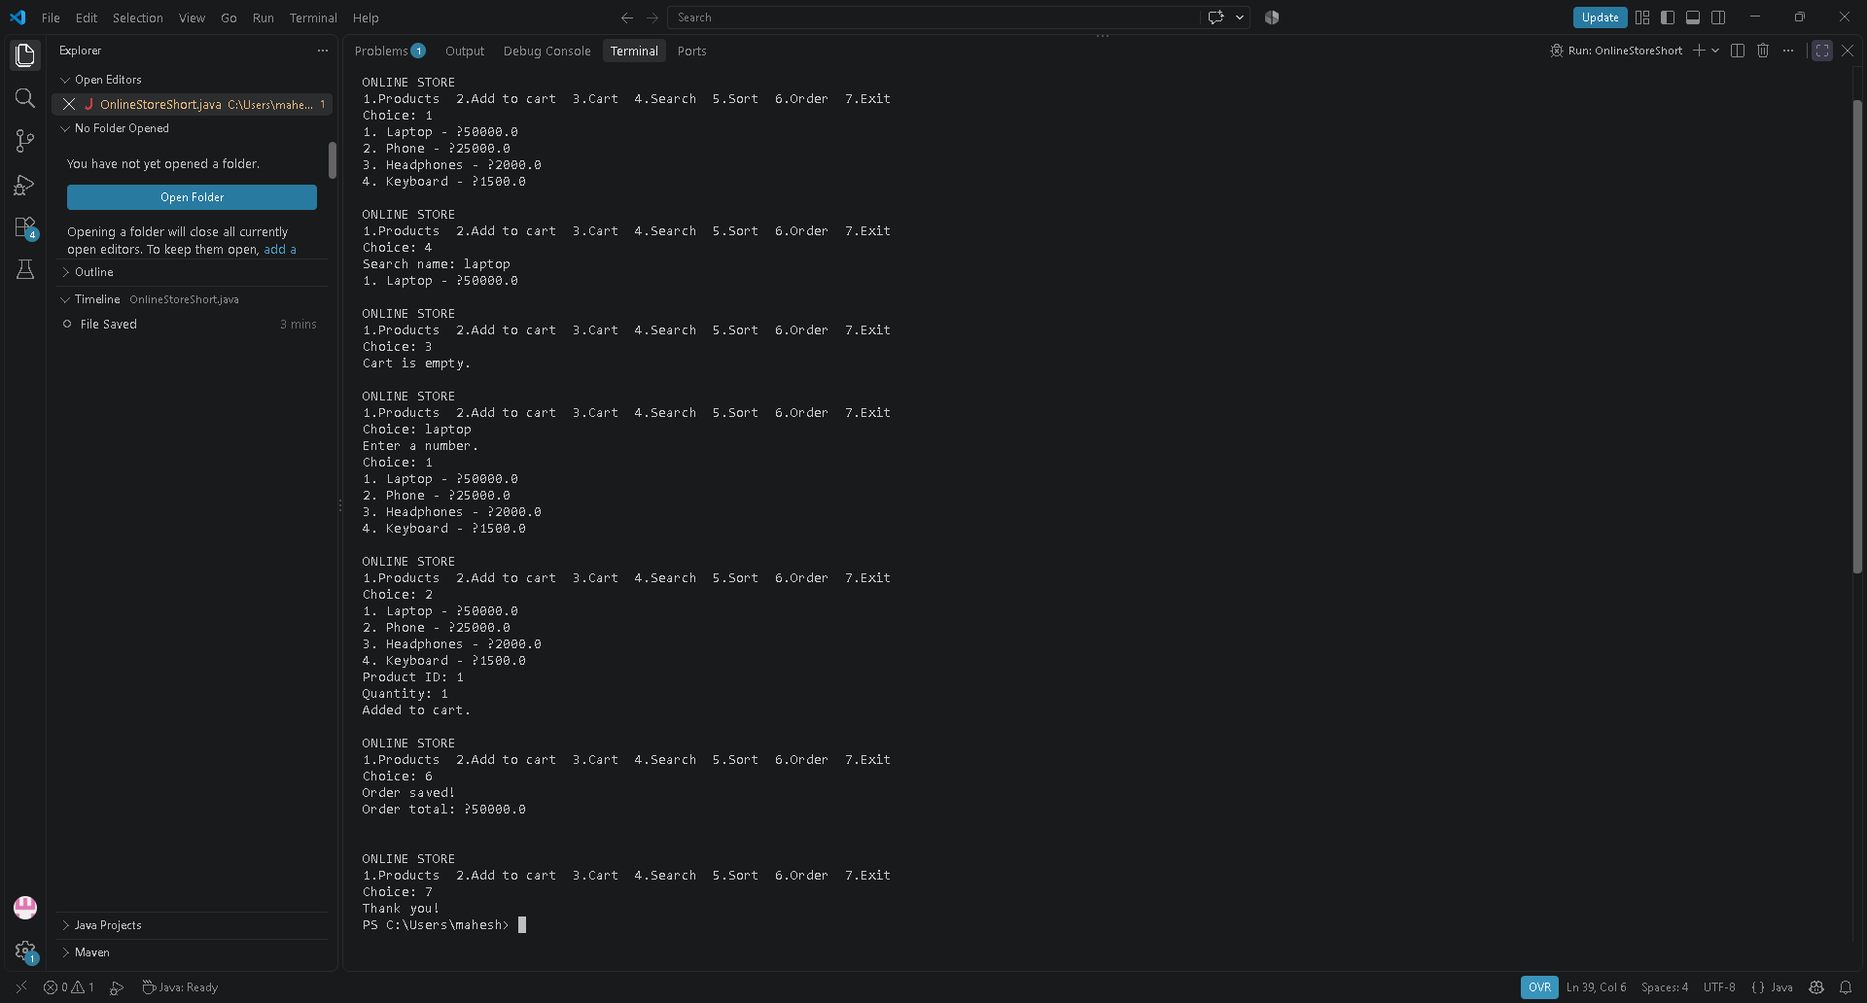
SCREENSHOTS
PROGRAM EXECUTION EVIDENCE
Observed run: product listing, search, empty-cart handling, add-to-cart, order saving and exit.
ONLINE STORE CART AND ORDER PIPELINE | JAVA PROJECT
11 / 12

Slide 12
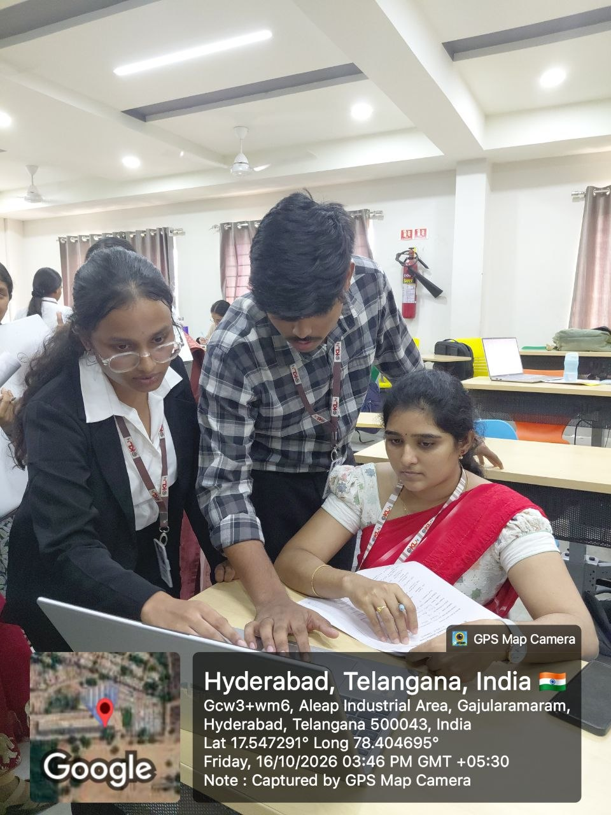
GEO-TAGGED PHOTO & GITHUB
SUBMISSION DETAILS
GEO-TAGGED TEAM PHOTO
https://github.com/yalamanchilitoshita/JAVA-PROJECT
GITHUB REPOSITORY
TEAM MEMBERS
Toshita Yalamanchili | 2620030361
V. Mahesh | 2620030339
ONLINE STORE CART AND ORDER PIPELINE | JAVA PROJECT
12 / 12

